Slide 1
Office 365 Development

Slide 2
Course Agenda
Introduction to Office 365 Development
Module 1: Deep Dive Apps for Office in Outlook
Module 2: Deep Dive Apps for Office in Word
Module 3: Deep Dive Apps for Office in PowerPoint
Module 4: Deep Dive Apps for Office in Excel
Module 5: Deep Dive into SharePoint Hosted Apps
Module 6: Deep Dive into Provider Hosted Apps
Module 7: Deep Dive into Security and OAuth
Module 8: App Lifecycle Management

Slide 3
Deep Dive in Office Outlook Add-ins

Slide 4

Agenda
Intro to Mail Add-ins
Contextual Activation and Rules
Office.js API Outlook
Compose Add-ins
Outlook Add-in Vision

Slide 5















Vision
EXTEND OFFICE EVERYWHERE
CONNECT TO OFFICE 365 SERVICES
BUILD USING AN OPEN PLATFORM
Delve
z
Users and groups
Files
Mail
Calendar
My Apps
Video Portal
Contacts
Office Graph
Presentations
Documents
Spreadsheets
Lync
OneNote
Yammer

Slide 6
What is an Office Add-in?
Web application loaded inside an Office Application
Embedded inline or as task pane within documents, mails or appointments.
Works in Office Applications such as Microsoft Outlook
Works in Office Web Applications such as OWA
Works in mobile Office clients
Office application extensions using Web technologies
HTML 5 and CSS used to construct user interface
JavaScript and jQuery used to add executable logic and event handlers
Add-in can provided code to read/write content to/from Office documents
Add-in can call Web services hosted over Internet or running within local network
Notes:
An App for Office can be seen as a Web page loaded inside an Office Application. In some cases it will appear embedded inline within the document. In other cases it might appear as a task pane or within a message in Outlook. Note that the architecture for Apps for Office has been designed to work in both Office Applications and Office Web Applications.
WEF and Apps for Office allow Office applications to be extended in such as way so that they can leverage Web technologies such as HTML 5 and CSS for rendering user interface as well as JavaScript and jQuery to add behavior. When you write the JavaScript code for an App for Office, you can call REST APIs such as those added to SharePoint 2013 to retrieve and update data from across network.

Slide 7
Add-in Capabilities
Rule-based activation
Add-ins can appear based on regex match
Based on presence of entities (eg postal address, meeting suggestion)
Based on presence of attachments
Based on type of item
Extensive JS object model API
Access to core item properties in read and compose
Access to body and attachments
Ability to modify fields and add attachments in compose
Launch native reply and new appointment forms
Ability to set custom properties on items

Slide 8
Single Sign On
Exchange and Outlook.com generate a token
Add-in validates token and maps it to known user id
Token:
{
"aud" : "https://mailhost.contoso.com/IdentityTest.html",
"iss" : "00000002-0000-0ff1-ce00-000000000000@mailhost.contoso.com",
"nbf" : "1331579055",
"exp" : "1331607855",
"appctxsender":"00000002-0000-0ff1-ce00-000000000000@mailhost.context.com",
"isbrowserhostedapp":"true",
"appctx" : {
"msexchuid" : "53e925fa-76ba-45e1-be0f-4ef08b59d389@mailhost.contoso.com",
"version" : "ExIdTok.V1“,
"amurl" : "https://mailhost.contoso.com:443/autodiscover/metadata/json/1"
}
}

Slide 9



Designing Office Add-ins - Shapes
Office Add-ins come in different shapes
Task Pane Add-in
Content Add-in
Mail Add-in
Mail Compose Add-in
Word Application
Excel Application
Outlook Application
Outlook Application
Document
Task Pane App
Document
Inbox
Selected Message
Inbox
New Message
Mail Compose
App
Reply | Reply All | Forward
To: xxx@yyy.com
Subject: Top secret stuff
app
Mail App
Content App
Message Body
Message Body
Notes:
When you begin to design an app, you must pick one of the three different shapes. You can create a document-based app as either a Task Pane App or a Content App. Alternatively, you can create a Mail App that targets Outlook and Outlook OWA.

Slide 10

Anatomy of an Office Add-in
Each Office Add-in is based on XML-based manifest
Manifest points to a Web page
Manifest defines the type of the Office Add-in
Manifest defines which Office applications it supports
Manifest defines required capabilities
Office Add-in
Office Add-in
Manifest
<XML>
Web
Page
HTML+JS
Notes:
Every App for Office must be distributed with an XML-based manifest which contains information about the app itself. For example, the app manifest contains an address to a Web page on the Internet which is used to load the app. The app manifest also includes information which indicates which Office applications it supports. The app manifest also defines the required capabilities which represent the set of permissions that the app needs in order to run and complete its work.

Slide 11
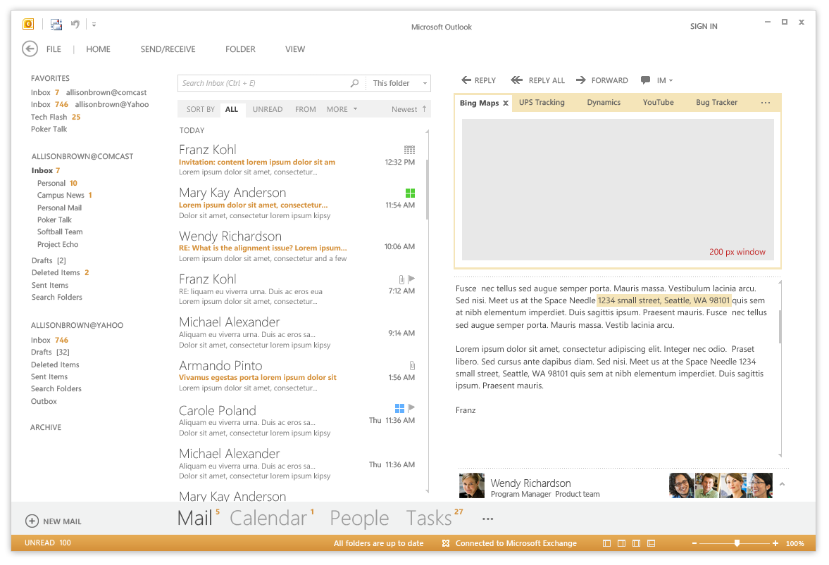
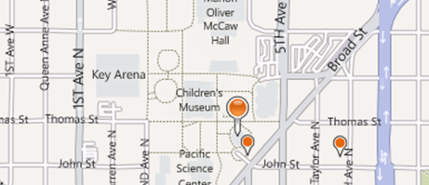
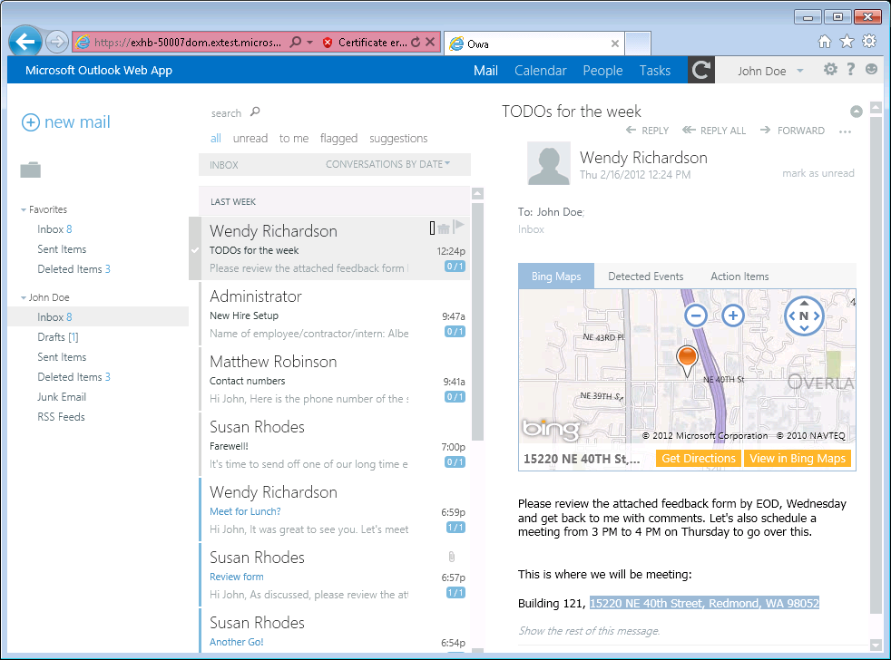
Mail Add-in
Write once, run anywhere Outlook runs
Same Mail Add-in runs in Outlook, OWA and Office mobile clients
Development based on activation rules
Activation rules run whenever user selects item
Activated mail add-ins are added into Outlook UI
Designed to be secure
Mail apps run in an isolated, sandboxed process
Mails apps run with a three-tier permission model
Mail Add-ins Require Exchange 2013 or Office 365
Notes:
A key concept of mail apps is that they are written once and can run anywhere Outlook runs including the rich client, the browser and mobile devices. The development model for mail apps based on activation rules. The idea is that activation rules for all installed mail apps run whenever user selects item. All mail apps whose activation rules result in activation are then available to use within the context of that selected item. Furthermore, the experience of app activation and starting a mail app is consistent across Outlook and OWA. When a mail app is started by the user, the mail app is designed to provide the user with contextual information for the selected e-mail message, meeting request, or appointment.
The infrastructure for mail apps has been designed to be secure. With Outlook, mail apps are run in an isolated, sandboxed process. In the browser, mail apps are isolated within their own iFrame. As you will see later in this model, mails apps run with a three-tier permission model which affords a great deal of power in a secure manner.

Slide 12

Mail Add-ins – Up Close and Personal
Add-in Name
Mail Add-in Body
Context trigger
Notes:
This slide shows some key aspects of how mail apps integrate into the Outlook and OWA user interface.
When a mail app has activated for a specific Outlook item, its App Name appears in a special App Bar just above the body of the host mail item. A user can start up a mail app by clicking on the App Name in the App Bar. This action results in the mail app loading which will display the Mail App Body. Many activation rules for mail apps are based on finding specific types of content in the host item. For example, the Bing Maps mail app looks for content inside the body that is interested as an address. Such content is considered a Context Trigger and is highlight in the body of the mail item showing the user what specific data the mail app is using to do its work.

Slide 13
Mail Add-in Hosting
Exchange Server
Hosts mailboxes for users
Host Mail Add-in Manifests
Mail Add-insrequire Exchange 2013
Exchange Server hosts users mailbox
Exchange Server hosts app manifest files
Web server hosts HTML for Mail Add-in
Mail Add-in can make callback to Web server
EWS
Web Server
Hosts HTML, CSS and JavaScript
Notes:
The infrastructure for mails apps require Exchange 2013 and an Exchange Server which hosts users mailboxes. When a mail app is installed, its manifest must be uploaded into the Exchange App Catalog. However, the implementation for a mail app which includes HTML, CSS and JavaScript is not deployed with Exchange but instead on any standard Web server that can serve up HTML pages.
One powerful aspect of developing mail apps is that they can call Exchange Web Services (EWS) which provides the ability to create new email message and appointments and to read other mail items in the current users inbox. Calls to EWS can be made directly from JavaScript behind the mail app itself. However, the mail app can also call back to its hosting Web server passing the required security credentials so that the Web server can call into EWS. This makes it possible to work with server-side code behind a mail app that does its work in C# and VBNET and still has the power to call into EWS.

Slide 14
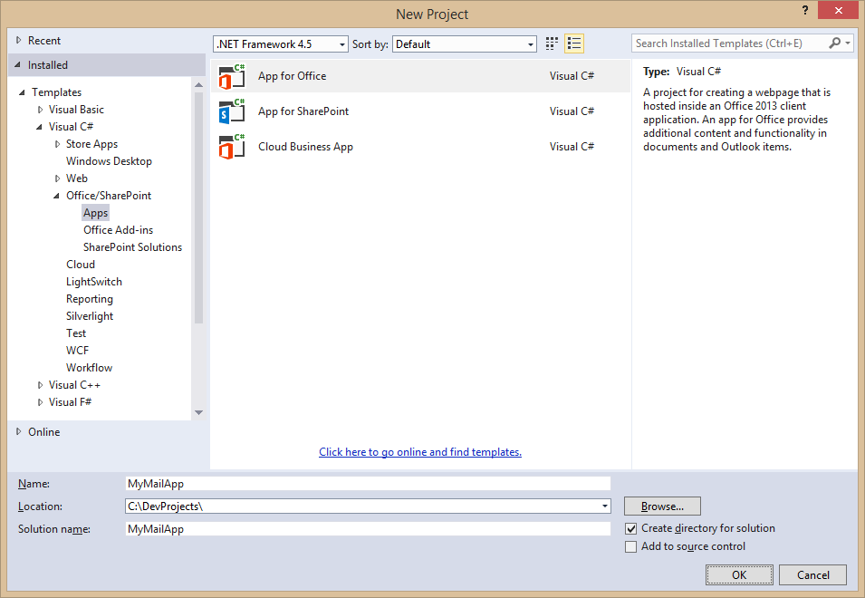
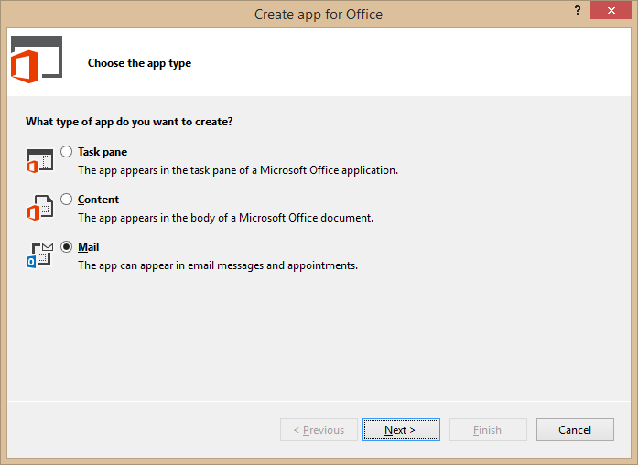
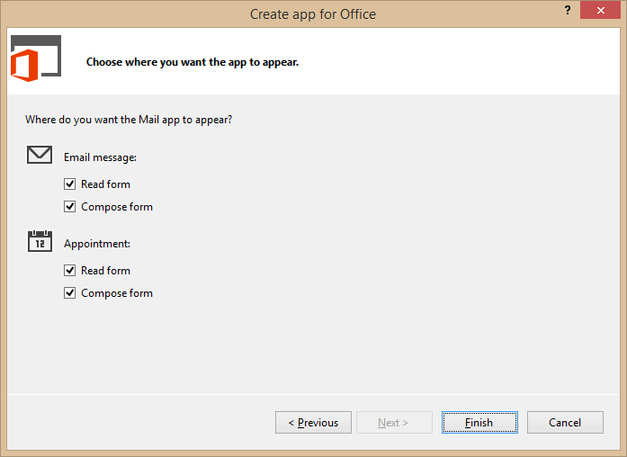
Developing Mail Add-ins
Use the Visual Studio project template for Mail Add-ins
Notes:
To create mail app, you can use Visual Studio and a new project template dedicated to creating mail apps.

Slide 15
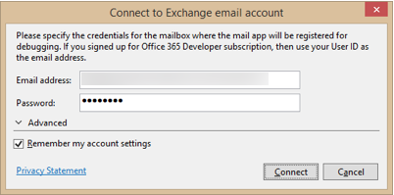
Steps to Implementing, Testing and Debugging
Specify height from 32 to 350 pixels
Define activation rules
Create UI and style with CSS
Write JavaScript to add behavior and business logic
Debug using Exchange Server and a valid Exchange account
Press {F5} and Visual Studio prompts for server and user mailbox credentials
Notes:
This slide details the high-level steps of creating a mail app. Within the app manifest, you should specify a height for the mail app between 32 pixels to 350 pixels. Note that you cannot specify the width as the mail app will take up all the available width in the host application. Next, you define one or more activation rules. Next, you create the user interface for the mail app using HTML5 and CSS. After that, you write JavaScript to add the required behavior and business logic. When you are finally ready to test your work, you can press the {F5} key to begin the debugging process.
In order to test and debug a mail app, you must have a installed version of Exchange 2013 and a valid Exchange account with a mailbox. When you press the {F5} key for the first time Visual Studio 2012 prompts you with the dialog shown above to track the server running Exchange 2013 as well as the login credentials for the user mailbox used for testing.

Slide 16
demo
Creating and Testing a Mail Add-in for Outlook

Slide 17
Contextual Activation and Rules

Slide 18
Rule-based Activation
Mail Add-ins activate based on rules
Rules are defined in the manifest
Rules are applied to the selected item in the Explorer or Inspector
If conditions are met, the Add-in will be activated and available for use
About rules
Multiple rules can be combined for complex activation needs
Apply logical AND or OR operators
Rules can access known entities such as phone numbers
Rules can be defined using regular expressions
Notes:
Every mail app is created with one or more activation rules. These rules are defined in the app manifest using XML. These activation rules are run for each installed mail app whenever the user select a new mail item that is a mail message, and event or an appointment. If the conditions for an activation rule are met, then the mail app is activated and becomes available to start by the user.
A simple mail app can be based on a single activation rule. However, a mail app can contain multiple rules that can be combined for complex activation needs. When you add more than one activation rule, you must decide whether to AND the rules together or to OR the rules together.
Activation rules can be based on known entities such as address and phone numbers. For more specific scenarios, activation rules can also be defined using custom regular expressions.

Slide 19
Activation Rule Types
ItemIs
A rule that checks the item type (appointment or message)
<Rule xsi:type=“ItemIs” ItemType=“Message”>
ItemHasKnownEntity
A rule to check if the item has a specific type of known entity
<Rule xsi:type=“ItemHasKnownEntity” EntityType=“Address” />
ItemHasRegularExpressionMatch
Defines a rule using a custom regular expression to match the contents of an item
RuleCollection
Defines a rule composed of multiple rules (combined using AND or OR)
Notes:
There are several different types of activation rules.
The ItemIs rule checks to see whether the item type is a message or an appointment.
<Rule xsi:type=“ItemIs” ItemType=“Message”>
The ItemHasKnownEntity rule checks to see if the item has a specific type of known entity
<Rule xsi:type=“ItemHasKnownEntity” EntityType=“Address” />
The ItemHasRegularExpressionMatch rule checks to see if an item has content that matches custom regular expression.
The RuleCollection rule combines two or more inner rules using either the AND operator or the OR operator. When using the AND operator, all inner rules must be met for activation to occur. When using the OR operator, only one inner rule must be met for activation to occur.

Slide 20
Well-known Entity Examples
Outlook is aware of specific types of entities
Items are parsed and scanned for common types of entities
Use ItemHasKnownEntity rules to based activation rules on entities
Within app use API functions getEntities or getEntitiesByType
Entity type | Recognition condition
Address | United States street addresses 1 Microsoft Way, Redmond, WA 07722
EmailAddress | Any SMTP email address
MeetingSuggestion | A reference to an event or meeting Let’s meet next Tuesday for lunch.
Contact | A personal name related to other entities Steve Ballmer, Microsoft, 1 Microsoft Way, Redmond, WA 07722
PhoneNumber | United States telephone numbers (507) 555-1212
TaskSuggestion | Actionable sentences in an email Please install Office 2013 on my computer.
Url | A file name or web address
Notes:
Outlook 2013 is aware of several specific well-known types of entities which are listed in the table on the slide above. When you create an activation rule based on one of these entities, Outlook will parse and scan the current item for the presence of content that matches that type of entity.
To create an activation rule based on a well-known entity with XML inside the app manifest, you use the ItemHasKnownEntity rule
<Rule xsi:type=“ItemHasKnownEntity” EntityType=“Address” />
When you are writing JavaScript code for the mail app, you will need to retrieve the entity value which can be done using the API functions getEntities or getEntitiesByType.

Slide 21
Office.js API

Slide 22
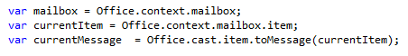
Accessing the Office.js API for Outlook
Outlook Add-in API available through mailbox
Office
context
mailbox
Message
Item can be cast to one of four different types
Message Compose
item
Appointment
Appointment Compose
Notes:
Access to the Outlook JavaScript Object Model (JSOM) is available through the Office.context.mailbox object. From here you can obtain access to information about the selected mail item and user profiles for the current user as well as other users such as the one that sent the message.

Slide 23
demo
Programming an Add-in for Outlook Using Javascript

Slide 24
Compose Add-ins

Slide 25
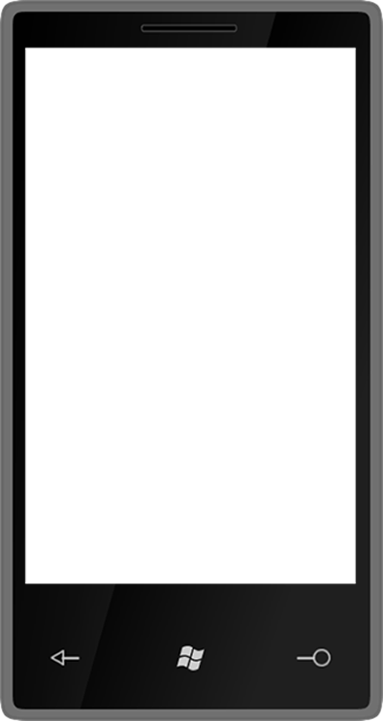

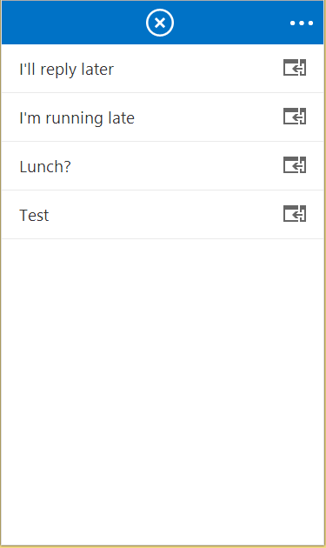
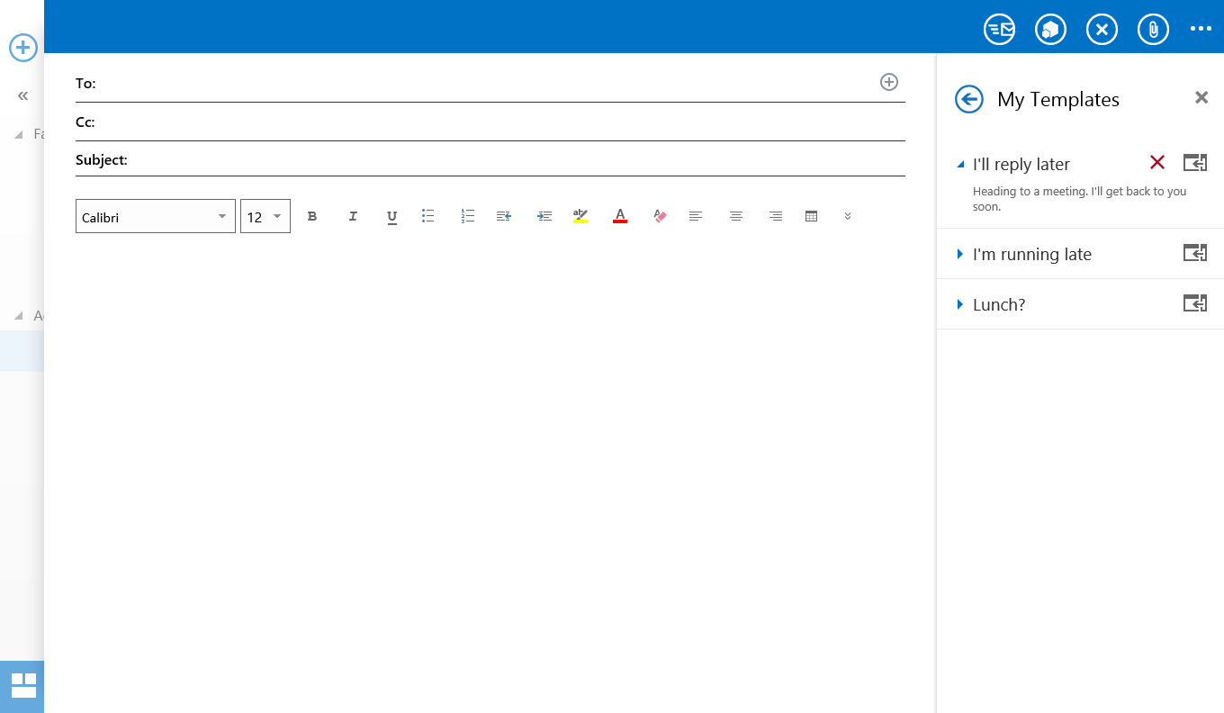
Compose Add-ins Activation
Add-ins can appear in messages and/or appointments
Compose apps are across Desktop, Tablet and Mobile

Slide 26
Compose Mail Add-ins capabilities
Use core JS APIs
Read/Write recipients
Read/Write subject
Add attachments
Write to the body
R/W appointment properties
Custom item properties
User Identity Token
O365 API requests
Settings
User Profile

Slide 27
Compose Mail Add-ins capabilities
Use core JS APIs
Read/Write recipients
Read/Write subject
Add attachments
Write to the body
R/W appointment properties
Custom item properties
Get/set/add recipients or
attendees
Get/set the subject

Slide 28
Compose Mail Add-ins capabilities
Use core JS APIs
Read/Write recipients
Read/Write subject
Add attachments
Write to the body
R/W appointment properties
Custom item properties
Add file or item attachments

Slide 29
Compose Mail Add-ins capabilities
Use core JS APIs
Read/Write recipients
Read/Write subject
Add attachments
Write to the body
R/W appointment properties
Custom item properties
Prepend to the body
Overwrite current selection in body

Slide 30
Compose Mail Add-ins capabilities
Use core JS APIs
Read/Write recipients
Read/Write subject
Add attachments
Write to the body
R/W appointment properties
Custom item properties
Get/set start or end time
Get/set location
Get/set/add attendees

Slide 31
Compose Mail Add-ins capabilities
Use core JS APIs
Read/Write recipients
Read/Write subject
Add attachments
Write to the body
R/W appointment properties
Custom item properties
Saved on the sent item
Can be used to mark a composed message (eg “Tracked” in CRM)

Slide 32
demo
Creating a Translation Compose Mail Add-in

Slide 33
Outlook Add-in Vision

Slide 34
Outlook Add-in Vision
Add-ins must feel native and intuitive
Leverage UI framework of host client
Entry points must scale gracefully
Write once, run everywhere

Slide 35
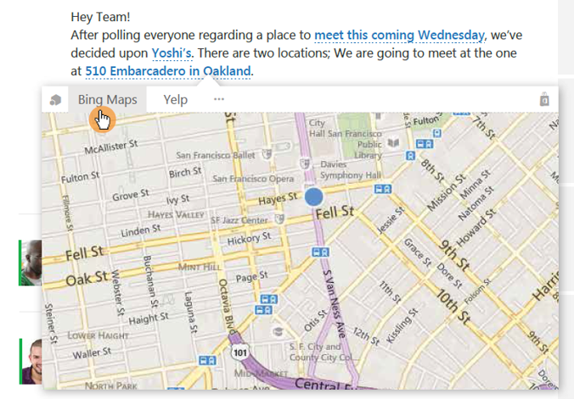
Body Text Highlighting
Outlook will highlight regex matches and entities against plain text body
Clicked on entity or regex match will be passed into add-in
Add-in is loaded in a hover card experience

Slide 36
Add-in Commands
1-click way for users to take add-in actions
In Outlook desktop, actions are ribbon buttons and can:
Launch task pane
Execute a JavaScript function without showing UI
Dropdown (menu) with different types of buttons as options [coming later]
Support backwards compatibility

Slide 37
Commands UI
Scales with the rest of the ribbon
Commands can be on default tab, or create 1 custom tab
Up to 6 buttons per group
1 group on default tab, up to 10 groups on custom tab
Commands that don’t launch UI can show status messages on the mail item or appointment

Slide 38
Summary
Intro to Mail Add-ins
Contextual Activation and Rules
Office.js API Outlook
Compose Add-ins
Outlook Add-in Vision

Slide 39



dev.office.com
Sign up
http://dev.office.com/getting-started
Explore
http://apisandbox.msdn.microsoft.com
Get trained http://dev.office.com/training

Slide 40


Feedback
Office 365 Network Share you best practices and join conversations https://www.yammer.com/itpronetwork
Stackoverflow Ask deep technical questions to a world-wide set of developers
http://stackoverflow.com/questions/tagged/ms-office
UserVoice Provide suggestions of what you want in future versions
http://officespdev.uservoice.com/

Slide 41

© 2012 Microsoft Corporation. All rights reserved. Microsoft, Windows, and other product names are or may be registered trademarks and/or trademarks in the U.S. and/or other countries.
The information herein is for informational purposes only and represents the current view of Microsoft Corporation as of the date of this presentation. Because Microsoft must respond to changing market conditions, it should not be interpreted to be a commitment on the part of Microsoft, and Microsoft cannot guarantee the accuracy of any information provided after the date of this presentation. MICROSOFT MAKES NO WARRANTIES, EXPRESS, IMPLIED OR STATUTORY, AS TO THE INFORMATION IN THIS PRESENTATION.

